Slide 1
Year to Date Visitor Insights
STR Destination Report - BC Regions
December 2021 - August 2022
With Yearly averages for 2017-2021

Slide 2
Occupancy - Year to Date Average
2017 - August 2022
Source: STR/BCHA/BCRTS Destination Year To Date - August 2022
Key Findings
In 2022, so far, the average across BC regions is 66.6% however, this may change as the year progresses
BC's average occupancy rate for the three years 2017-2019 was 70%, until 2020 when it dropped to 40%. From 2020 to 2021 all regions have increased and all but Whistler continue to be under 60%
Across the three years leading up to 2020, Vancouver had the highest occupancy rate averaging in the 79% range until 2020 when Vancouver fell below the BC average and stayed there for 2021 and 2022 so far
Over the three years 2019-2022 Vancouver Island averaged 70% Whistler averaged 67% Thompson Okanagan averaged 59% Cariboo Chilcotin Coast averaged 59% Northern BC averaged 58% and Kootenay Rockies averaged 52%
Note Provincial State of Emergencies
British Columbia declared a Provincial State of Emergency due to the COVID-19 Pandemic on March 18, 2020.
Provincial State of Emergency due to Wildfires on July 20, 2021
Provincial State of Emergency due to widespread flooding and landslides on November. 17, 2021.
2 I Year To Date STR Report

Slide 3
Occupancy - Average by month
2022
Source: STR/BCHA/BCRTS Destination Year To Date - August 2022
Key Findings
In August 2022, the BC Average Occupancy rate is 81.1%
Vancouver had the highest occupancy in August 2022 with 85.7%, followed closely by Vancouver Island at 84.2%
Northern BC has the lowest occupancy in August 2022 with 65.8%
Note Provincial State of Emergencies
British Columbia declared a provincial state of emergency on Wednesday, March 18, 2020. Travel within British Columbia was restricted to essential needs only from May 23, 2021 and was ongoing until June 15, 2021 by order and direction of the Ministry of Public Safety in consultation with BC's Provincial Health Officer.
British Columbia entered a Provincial State of Emergency due to Wildfires on July 20, 2021 and was ongoing until September 14, 2021.
British Columbia declared a provincial state of emergency due to widespread flooding and landslides on November. 17, 2021 to January 18, 2022.
3 I Year To Date STR Report

Slide 4
Occupancy - Monthly percent change Year to Date
2022 compared to 2019
Source: STR/BCHA/BCRTS Destination Year To Date - August 2022
Key Findings
The BC Average YTD variation was -4.7% when comparing August 2022 to 2019
Vancouver Island had the smallest variation in occupancy in August 2022 with a -3.6% change from year to date 2019
Whistler had the largest variation in occupancy with a -21.2% change, followed by Cariboo Chilcotin Coast with a 14.2% change in August 2022 from year to date 2019
Note Provincial State of Emergencies
British Columbia declared a provincial state of emergency on Wednesday, March 18, 2020. Travel within British Columbia was restricted to essential needs only from April 23, 2021 and was ongoing until June 15, 2021 by order and direction of the Ministry of Public Safety in consultation with BC's Provincial Health Officer.
British Columbia entered a Provincial State of Emergency due to Wildfires on July 20, 2021 and was ongoing until September 14, 2021.
British Columbia declared a provincial state of emergency due to widespread flooding and landslides on November. 17, 2021 to January 18, 2022.
4 I Year To Date STR Report

Slide 5
Average Daily Rate - Year to Date Average
2017 - August 2022
Source: STR/BCHA/BCRTS Destination Year To Date - August 2022
Key Findings
In 2022, so far, the average across BC regions is $221.34 however this may change as the year goes on
Across the five years, 2017-2021 Whistler had the highest ADR on average over $327, dipping slightly to $319 in 2020 and $307 in 2021
BC's average ADR for the three years 2017-2019 leading up to the pandemic was $189, dipped to $150 in 2020 and further to $134 for the first half of 2021 (through June) and at the end of December 2021 it’s $167
Vancouver, Vancouver Island, Whistler, Thompson Okanagan, and Kootenay Rockies were trending upwards during the three year period 2017-2019. NBC & CCC fluctuated with their highest rates in 2018 and 2017 respectively, dipping in 2019 in Northern BC but recuperating in CCC in 2019 close to 2017 rates. All regions dropped in 2020 but slowly recovered in 2021 and 2022
Across the three years from 2017 to 2019, average ADR for Vancouver was $206, Vancouver Island was $181, Whistler was $327, Thompson Okanagan was $138, Northern BC was $124 Kootenay Rockies was $138 and Cariboo Chilcotin Coast was $124
Note Provincial State of Emergencies
British Columbia declared a Provincial State of Emergency due to the COVID-19 Pandemic on March 18, 2020.
Provincial State of Emergency due to Wildfires on July 20, 2021
Provincial State of Emergency due to widespread flooding and landslides on November. 17, 2021.
5 I Year To Date STR Report

Slide 6
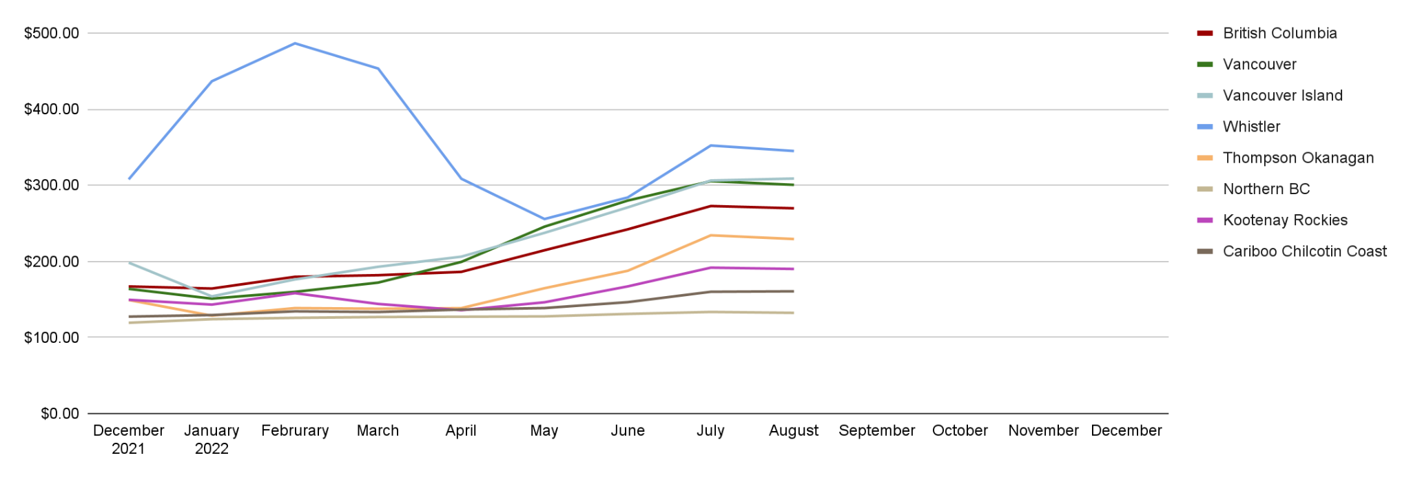
Average Daily Rate - Average by month
2022
Source: STR/BCHA/BCRTS Destination Year To Date - August 2022
Key Findings
The BC Avg ADR in August 2022 was $269.80
Whistler had the highest ADR in August 2022 with $345.10
Northern BC had the lowest ADR in August 2022 with $132.33
Note Provincial State of Emergencies
British Columbia declared a provincial state of emergency on Wednesday, March 18, 2020. Travel within British Columbia was restricted to essential needs only from April 23, 2021 and was ongoing until June 15, 2021 by order and direction of the Ministry of Public Safety in consultation with BC's Provincial Health Officer.
British Columbia entered a Provincial State of Emergency due to Wildfires on July 20, 2021 and was ongoing until September 14, 2021.
British Columbia declared a provincial state of emergency due to widespread flooding and landslides on November. 17, 2021 to January 18, 2022.
6 I Year To Date STR Report

Slide 7
Average Daily Rate - Monthly percent change Year to Date
2022 compared to 2019
Source: STR/BCHA/BCRTS Destination Year To Date - August 2022
Key Findings
The BC Avg variation in ADR comparing August 2022 to 2019 was 15.7%
Kootenay Rocking had the smallest variation in ADR in August 2022 with a 4.6% change from year to date 2019
Thompson Okanagan had the largest variation in ADR in August 2022 with a 32.0% change from 2019
Note Provincial State of Emergencies
British Columbia declared a provincial state of emergency on Wednesday, March 18, 2020. Travel within British Columbia was restricted to essential needs only from April 23, 2021 and was ongoing until June 15, 2021 by order and direction of the Ministry of Public Safety in consultation with BC's Provincial Health Officer.
British Columbia entered a Provincial State of Emergency due to Wildfires on July 20, 2021 and was ongoing until September 14, 2021.
British Columbia declared a provincial state of emergency due to widespread flooding and landslides on November. 17, 2021 to January 18, 2022.
7 I Year To Date STR Report

Slide 8
Revenue Per Average Room - Year to Date Average
2017 - August 2022
Source: STR/BCHA/BCRTS Destination Year To Date - August 2022
Key Findings
In 2022, so far, the average across BC regions is $147.36 however this may change as the year goes on
Across the five years, 2017-2021 Whistler had the highest RevPAR on average over $200, until 2020 when it dipped below $125, and evened at $109 in 2021, trending upwards for 2022
BC's average RevPAR 2017-2021: Leading up to the pandemic was $132, increasing each year with 2019 at $137 for the year. Year to date, BC's average RevPAR for Jan to Dec 2021, is $80.95, exceeding 2020
Across the years from 2017 to 2019, average RevPAR for Vancouver was $163, Vancouver Island was $125, Whistler was $220, Thompson Okanagan was $82, Northern BC was $72, Kootenay Rockies was $72, and Cariboo Chilcotin Coast was $74
Note Provincial State of Emergencies
British Columbia declared a Provincial State of Emergency due to the COVID-19 Pandemic on March 18, 2020.
Provincial State of Emergency due to Wildfires on July 20, 2021
Provincial State of Emergency due to widespread flooding and landslides on November. 17, 2021.
8 I Year To Date STR Report

Slide 9
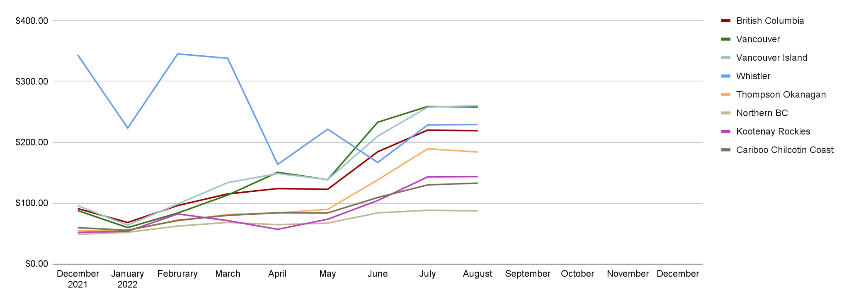
Revenue Per Average Room - Average by month
2022
Source: STR/BCHA/BCRTS Destination Year To Date - August 2022
Key Findings
The BC Average RevPAR for August 2022 was $218.84
Vancouver Island had the highest RevPAR in August 2022 with $260.15
Northern BC had the lowest RevPAR in August 2022 with $87.02
Note Provincial State of Emergencies
British Columbia declared a provincial state of emergency on Wednesday, March 18, 2020. Travel within British Columbia was restricted to essential needs only from April 23, 2021 and was ongoing until June 15, 2021 by order and direction of the Ministry of Public Safety in consultation with BC's Provincial Health Officer.
British Columbia entered a Provincial State of Emergency due to Wildfires on July 20, 2021 and was ongoing until September 14, 2021.
British Columbia declared a provincial state of emergency due to widespread flooding and landslides on November. 17, 2021 to January 18, 2022.
9 I Year To Date STR Report

Slide 10
Revenue Per Average Room - Monthly percent change
Year to Date - 2022 compared to 2019
Source: STR/BCHA/BCRTS Destination Year To Date - August 2022
Key Findings
The BC Avg variation in RevPAR was 10.3% comparing August 2022 to 2019
Whistler had the smallest variation in RevPAR in August 2022 with a 4.0% change from year to date 2019
Cariboo Coast/South Central BC had the largest variation in RevPAR in August 2022 with a 34.2% change from year to date 2019
Note Provincial State of Emergencies
British Columbia declared a provincial state of emergency on Wednesday, March 18, 2020. Travel within British Columbia was restricted to essential needs only from April 23, 2021 and was ongoing until June 15, 2021 by order and direction of the Ministry of Public Safety in consultation with BC's Provincial Health Officer.
British Columbia entered a Provincial State of Emergency due to Wildfires on July 20, 2021 and was ongoing until September 14, 2021.
British Columbia declared a provincial state of emergency due to widespread flooding and landslides on November. 17, 2021 to January 18, 2022.
10 I Year To Date STR Report

Slide 11
Property Participation
Census (Total Properties in Database)
Source: STR/BCHA/BCRTS Destination Year To Date - August 2022
British Columbia August Census total: 1350
Key Findings
Out of the regions, Thompson Okanagan had the highest number of properties in the STR database (Census) in August 2022 with 384
Whistler had the lowest number of properties in the STR database (Census) in August 2022 with 46
Note Provincial State of Emergencies
British Columbia declared a provincial state of emergency on Wednesday, March 18, 2020. Travel within British Columbia was restricted to essential needs only from April 23, 2021 and was ongoing until June 15, 2021 by order and direction of the Ministry of Public Safety in consultation with BC's Provincial Health Officer.
British Columbia entered a Provincial State of Emergency due to Wildfires on July 20, 2021 and was ongoing until September 14, 2021.
British Columbia declared a provincial state of emergency due to widespread flooding and landslides on November. 17, 2021 to January 18, 2022.
11 I Year To Date STR Report

Slide 12
Property Participation
Sample (Total Properties Submitting Data)
Source: STR/BCHA/BCRTS Destination Year To Date - August 2022
British Columbia August Census total: 420
Key Findings
Vancouver had the highest property participation with 130 out of the 191 properties reporting data in August 2022
Cariboo Chilcotin Coast had the lowest property participation with 21 out of the 191 properties reporting data in August 2022
Note Provincial State of Emergencies
British Columbia declared a provincial state of emergency on Wednesday, March 18, 2020. Travel within British Columbia was restricted to essential needs only from April 23, 2021 and was ongoing until June 15, 2021 by order and direction of the Ministry of Public Safety in consultation with BC's Provincial Health Officer.
British Columbia entered a Provincial State of Emergency due to Wildfires on July 20, 2021 and was ongoing until September 14, 2021.
British Columbia declared a provincial state of emergency due to widespread flooding and landslides on November. 17, 2021 to January 18, 2022.
12 I Year To Date STR Report

Slide 13
Glossary
Occupancy: Calculated by the number of occupied rooms divided by the number of available rooms that physically exist in a hotel
Average Daily Rate (ADR): Represents the average rental income per paid occupied room in a given time period, however, ADR itself cannot be used to measure a hotel’s performance
Revenue per Available Room (RevPAR): Calculated by multiplying a hotel’s ADR by its occupancy rate, an increase in RevPAR most likely indicates an improvement in occupancy rate and can be used to measure a hotel’s performance
STR FAQ https://str.com/data-insights/resources/faq
13 I Weekly Report

Slide 14
Contact Us
Karen Chalmers
Managing Director, Symphony Tourism Services
Email: karen@totabc.com
Phone: 778.721.5448
symphonytourismservices.com
30 I Weekly Report

